Slide 1
Online Multi-Target Tracking Using Recurrent Neural Networks
Supervisor: Kolja Thormann
AUTHOR : Chen Yifan

Slide 2
Outline
Introduction
Online Multiple Objects Tracking System
RNN and LSTM
MOT System
Object Detect
State Predicted
Data Association
State Update
Conclusion
Performance
Promotion

Slide 3
Outline
Introduction
Online Multiple Objects Tracking System
RNN and LSTM
MOT System
Object Detect
State Predicted
Data Association
State Update
Conclusion
Performance
Promotion

Slide 4
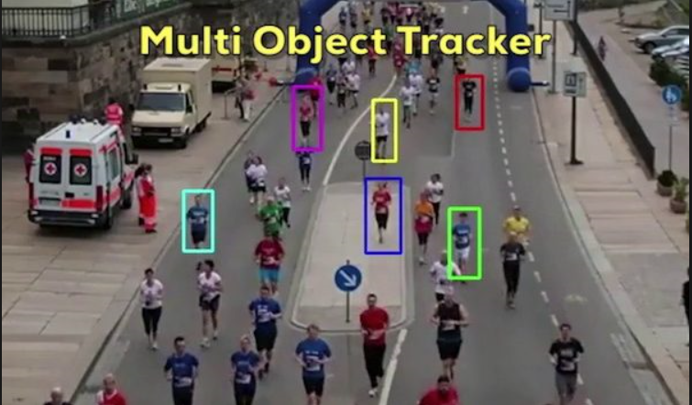
Data Fsuion
Online Multiple Objects Tracking System
Develop from single object tracking system
Locate a moving multiple objects
Against various challenges

Slide 5
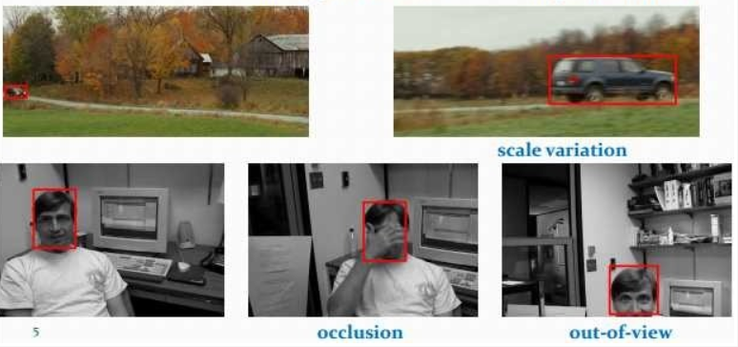
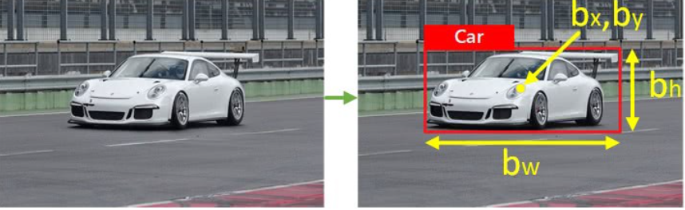
Data Fsuion
Online Multiple Objects Tracking System
Identify objects
Show in bounding box
Represent by bounding box coordinate
(x,y,w,h)
Challenges:
Scale variation
Defomation
Occlusion
......
Manivannan Murugavel Object Tracking — Referenced with the previous frame using Euclidean distance. 4.2019

Slide 6
Data Fsuion
Online Multiple Objects Tracking System
Distinguish between multiple objects
Track initiation and termination
Challenges:
Similarity
Interaction between objects
….
https://www.youtube.com/watch?v=SLyABs_nJeg

Slide 7
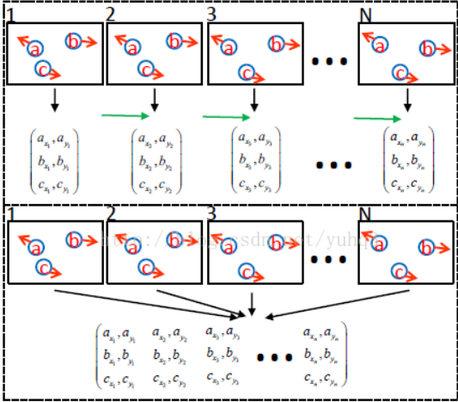
Data Fsuion
Online Multiple Objects Tracking System
Timely feedback system
Low delay
Online learning
Challenges:
Achieve the balance between
accuracy and efficiency
Lower robust against casual error
….
Luo, Wenhan, et al. "Multiple object tracking: A literature review." arXiv preprint arXiv:1409.7618 (2014).

Slide 8
Data Fsuion
Online Multiple Objects Tracking System
Current method:
Kalman Filter
Extended Kalman Filter
JPDA
SVM
CNN
RNN (First time)

Slide 9
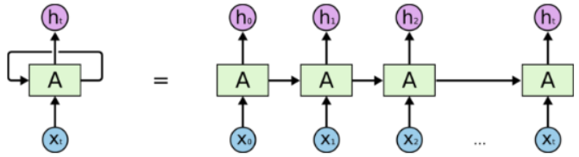
Data Fsuion
RNN
Combine of input layer, output layer, hidden layer
Learnable parameter: Hidden system state
Have memory, suitable for handling time series data
Suvro Banerjee An Introduction to Recurrent Neural Networks 5.2018

Slide 10
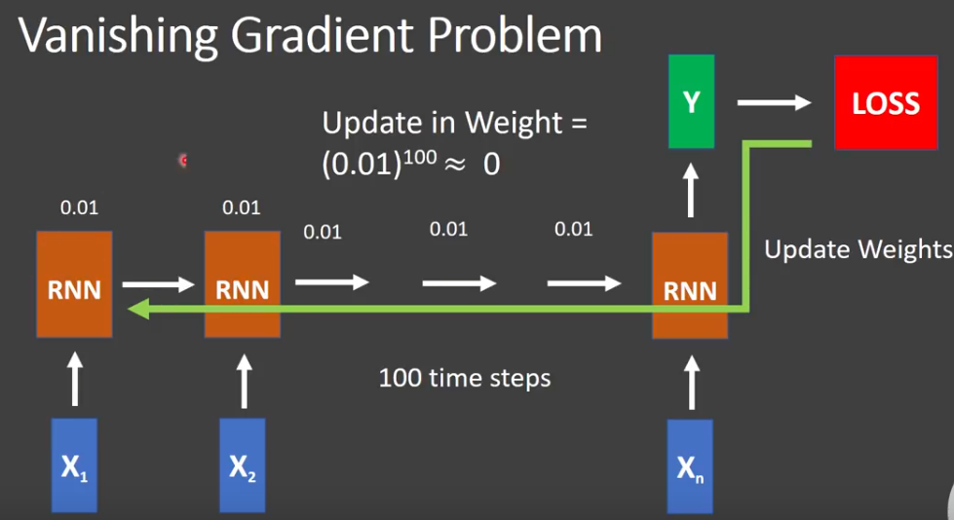
Data Fsuion
RNN
Hard to store long term memory due to ”Gradient Vanishing”
Unsuitable for data association Task
https://www.youtube.com/watch?v=S0XFd0VMFss

Slide 11
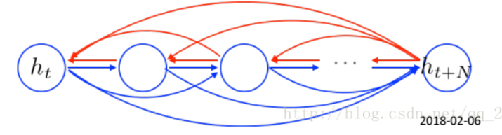
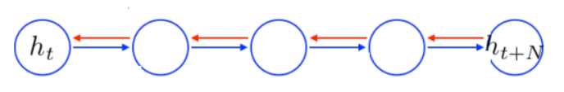
Data Fsuion
LSTM
Develop from RNN
Add forget gate and remember gate
Access remote history information without loss
RNN
LSTM
Vico_Men https://blog.csdn.net/qq_28031525/article/details/79423450 3.2018

Slide 12
Outline
Introduction
Online Multiple Objects Tracking System
RNN and LSTM
MOT System
Object Detect
State Predicted
Data Association
State Update
Conclusion
Performance
Promotion

Slide 13
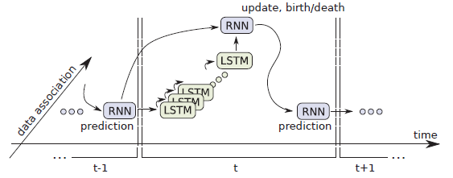
Data Fsuion
Online Multiple Objects Tracking System
Fours Steps:
Detect: Deformable Part Model Algorithm
Prediction: Recurrent Neural Network
Data Assignment: LSTM
Update: Recurrent Neural Network
Milan, Anton, et al. "Online multi-target tracking using recurrent neural networks." Thirty-First AAAI Conference on Artificial Intelligence. 2017.

Slide 14
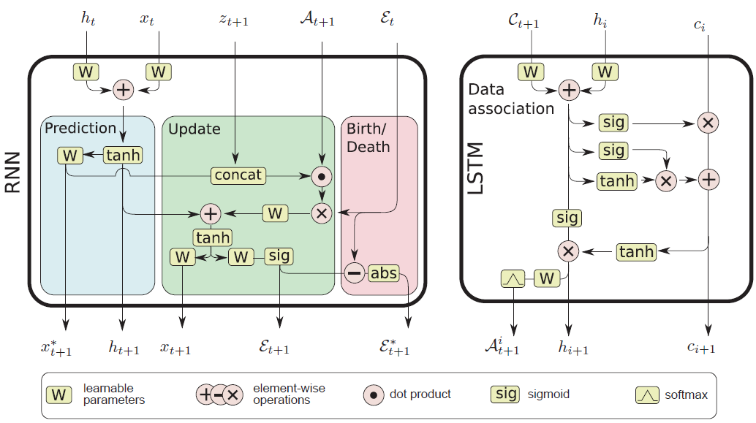
Data Fsuion
Topological Map
Milan, Anton, et al. "Online multi-target tracking using recurrent neural networks." Thirty-First AAAI Conference on Artificial Intelligence. 2017.

Slide 15
Data Fsuion
Object Detect
Deformable Parts Model
Develop from HOG (Histograms of oriented Gradients)
Detect object with noisy measurement

Slide 16
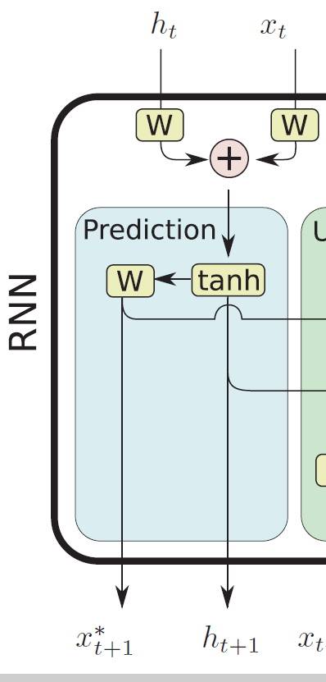
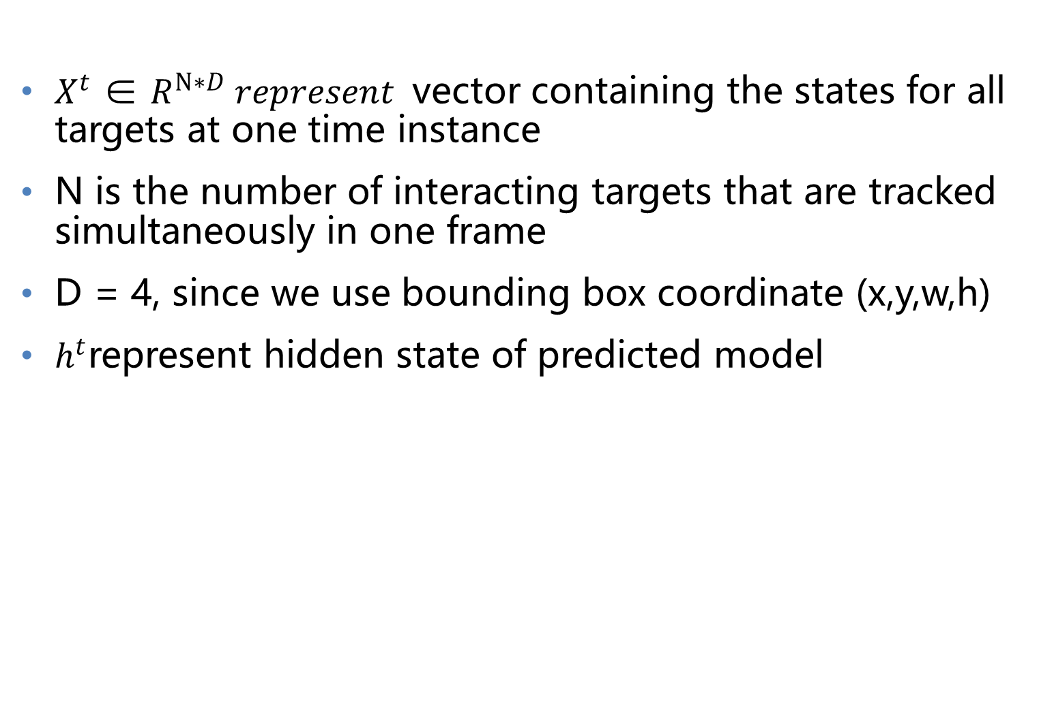
Data Fsuion
State Predicted
$X^{t}$ ∈ $R^{N∗D} represent$vector containing the states for all targets at one time instance
N is the number of interacting targets that are tracked simultaneously in one frame
D = 4, since we use bounding box coordinate (x,y,w,h)
$h^{t}$represent hidden state of predicted model
Milan, Anton, et al. "Online multi-target tracking using recurrent neural networks." Thirty-First AAAI Conference on Artificial Intelligence. 2017.

Slide 17
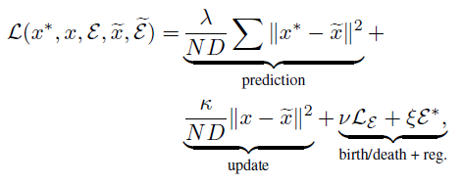
Data Fsuion
State Predicted
Learn dynamic model with labeled data
Used given loss function and backpropagation algorithm to update learnable parameter
Milan, Anton, et al. "Online multi-target tracking using recurrent neural networks." Thirty-First AAAI Conference on Artificial Intelligence. 2017.

Slide 18
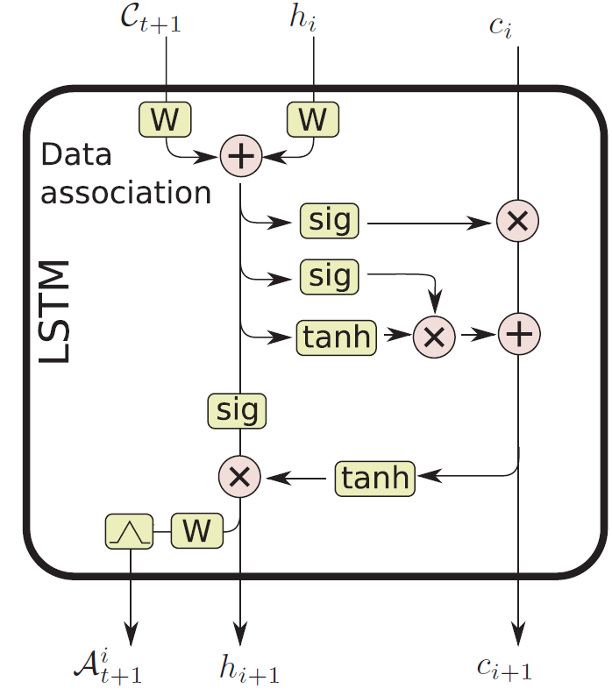
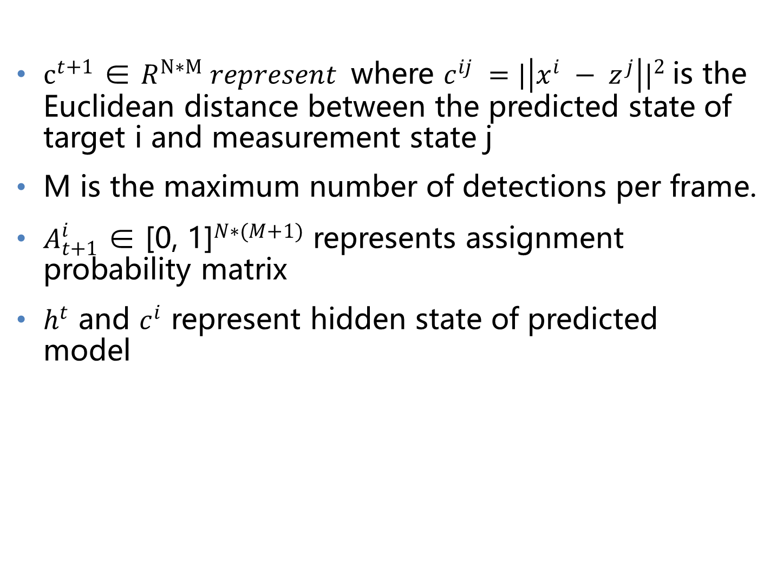
Data Fsuion
Data Association
$c^{t+1}$ ∈ $R^{N∗M} represent$where $c^{ij} ={|\left|x^{i} − z^{j}\right||}^{2}$is the Euclidean distance between the predicted state of target i and measurement state j
M is the maximum number of detections per frame.
$A_{t+1}^{i}$ ∈ ${\text{[0, 1]}}^{N∗(M+1)}$ represents assignment probability matrix
$h^{t}$ and $c^{i}$ represent hidden state of predicted model
Milan, Anton, et al. "Online multi-target tracking using recurrent neural networks." Thirty-First AAAI Conference on Artificial Intelligence. 2017.

Slide 19
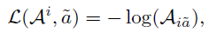
Data Fsuion
Data Association
Learn dynamic model with labeled data
Used given loss function and backpropagation algorithm to update learnable parameter
Milan, Anton, et al. "Online multi-target tracking using recurrent neural networks." Thirty-First AAAI Conference on Artificial Intelligence. 2017.

Slide 20
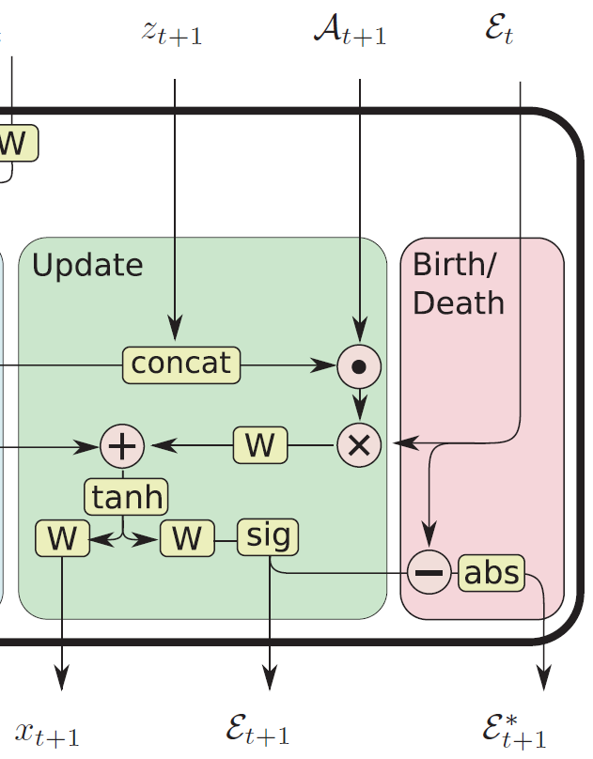
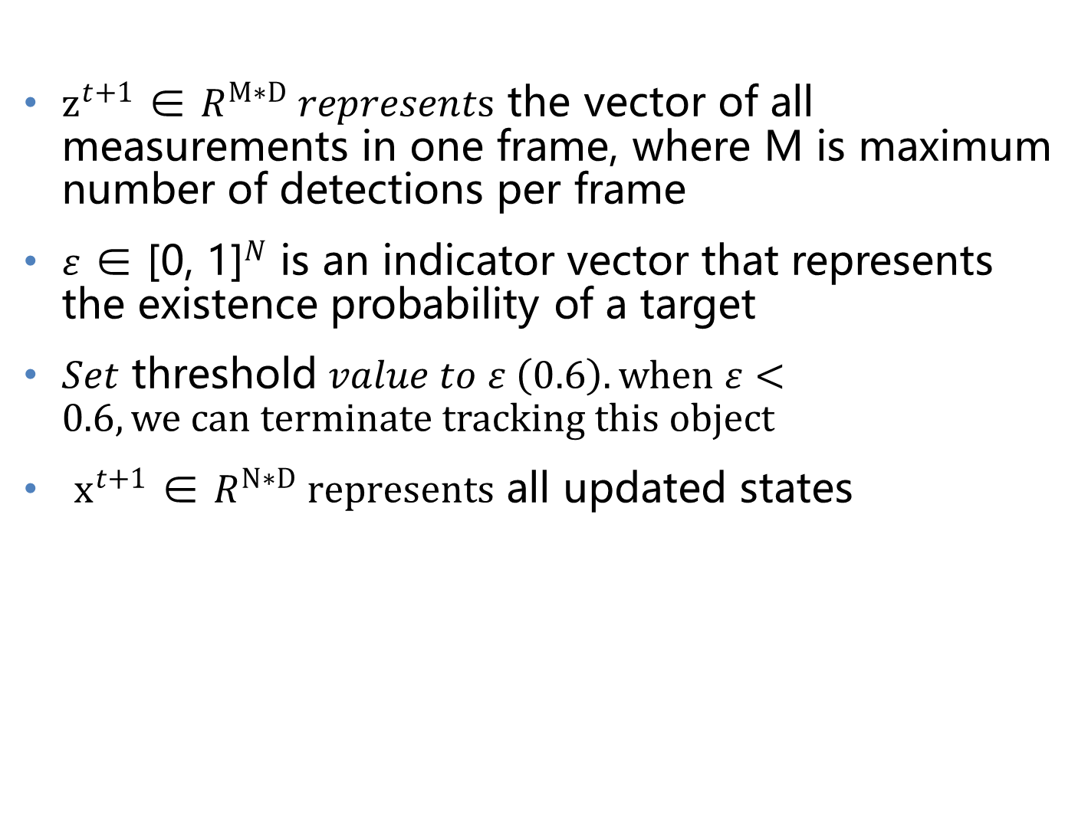
Data Fsuion
Data Update
$z^{t+1}$ ∈ $R^{M∗D} represents \text{the} \text{vector} \text{of} \text{all} \text{measurements} \text{in} \text{one} \text{frame}\text{, }\text{where} \text{M} \text{is} \text{maximum} \text{number} \text{of} \text{detections} \text{per} \text{frame}$
$ε$ ∈ ${\text{[0, 1]}}^{N}$ is an indicator vector that represents the existence probability of a target
$Set \text{threshold} value to ε \left(0.6\right).when ε<0.6, we can terminate tracking this object$
$x^{t+1}$ ∈ $R^{N∗D} represents$ all updated states
Milan, Anton, et al. "Online multi-target tracking using recurrent neural networks." Thirty-First AAAI Conference on Artificial Intelligence. 2017.

Slide 21
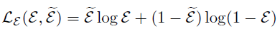
Data Fsuion
Data Update
Milan, Anton, et al. "Online multi-target tracking using recurrent neural networks." Thirty-First AAAI Conference on Artificial Intelligence. 2017.

Slide 22
Outline
Introduction
Online Multiple Objects Tracking System
RNN and LSTM
MOT System
Object Detect
State Predicted
Data Association
State Update
Conclusion
Performance
Promotion

Slide 23
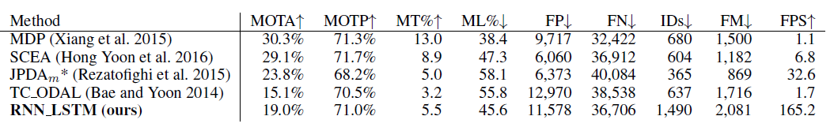
Data Fsuion
Performance
Not quite reach the top accuracy
Two orders of magnitude faster
Milan, Anton, et al. "Online multi-target tracking using recurrent neural networks." Thirty-First AAAI Conference on Artificial Intelligence. 2017.

Slide 24
Data Fsuion
Advantage
Use temporal data
Do not need prior knowledge
Timely system

Slide 25
Data Fsuion
Promotion
Long training period
Really bad explainability
Achieve the balance between online and offline method

Slide 26

Question time
Source:familybusinessunited.com

Slide 27
Reference
[1] P. K. Varshney . Multisensor data fusion. https://arxiv.org/pdf/1604.03635.pdf
[2] Vibhor nigam .Understanding Neural Networks. From neuron to RNN, CNN, and Deep Learning
[3] Josua Krause. Using Visual Analytics to Interpret Predictive Machine Learning Models
[4] A Milan.Online Multi-Target Tracking Using Recurrent Neural Networks

